Slide 1

Hospitality Project
Group Members
                Devyani Sonar
                Parvez Sheikh
                Khushi Vishwakarma
                Harsh Burman
                Rohini Ghule
                Gokila
                Ambika Malaji

Slide 2
Data Source
Data Source is about Hospitality Domain which comprise data such as Property Id, Property name, City, Booking Status, Booking Platform, Revenue Realized, Revenue Generated, Check In Date , Check Out Date , etc.
Dataset contains 5 CSV Files.
dim_date
dim_hotels
dim_rooms
fact_aggregated_bookings
fact_booking
Mertrics List

Slide 3
Data Cleaning
First Step in cleaning Data process is to create Master Table.
Master Table is created by joining all the given table with common column i.e. Property Id.
Cleaned the data in Power Query Editor by removing all nulls, duplicates and blanks. Ensure that all column as data type and new calculated column are created if required.
KPI are divided equally among team members to work.

Slide 4
Dasboards
Dashborad are created by using following tools.
Excel
2. Tableau
3. Power-BI

Slide 5
Company Overview
Hotels
Atliq Bay
Atliq Blu
Atliq City
Atliq Exotica
Atliq Grands
Atliq Palace
Atliq Seasons
City
Hyderabad
Bangalore
Delhi
Mumbai
Category
Standard
Elite
Premium
Presidential
BOOKING
PLATFORMS
Direct Offline
Direct Online
Journey
LogTrip
MakeyourTrip
Tripster
Others

Slide 6
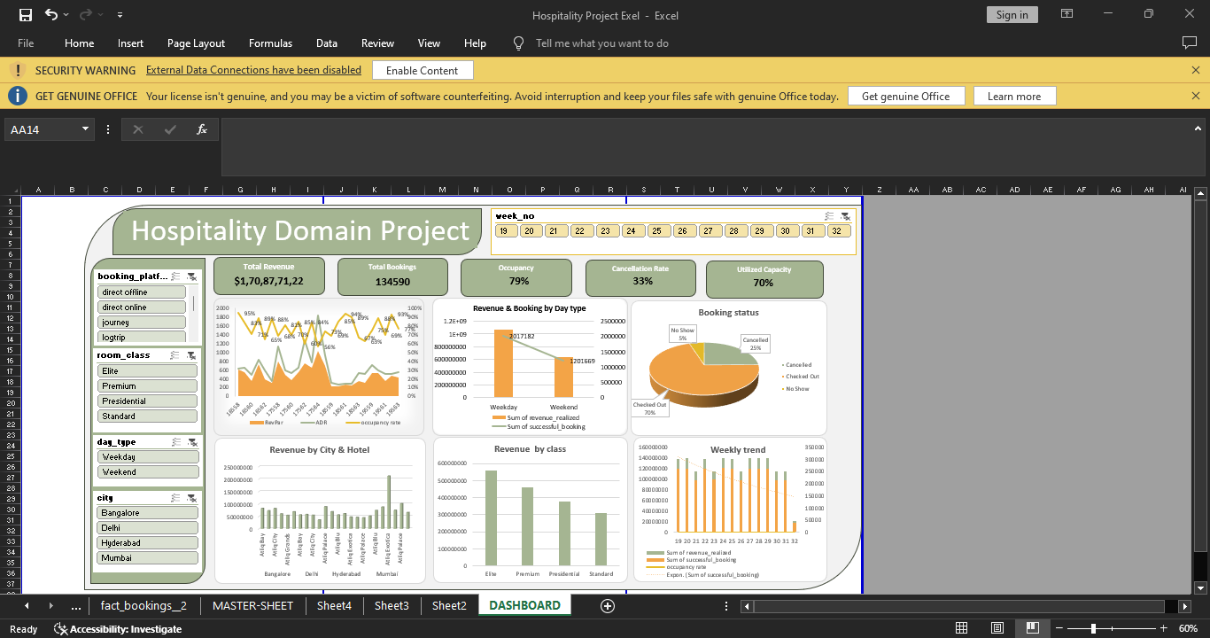
Excel Dashboard

Slide 7
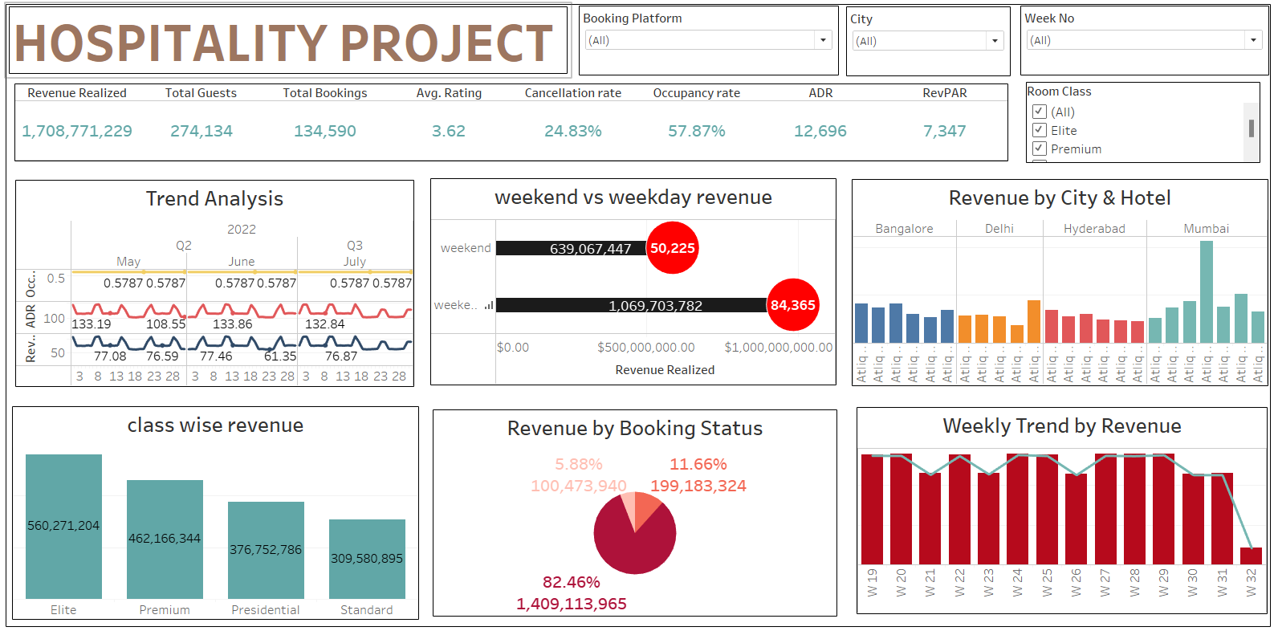
Tableau Dashboard

Slide 8
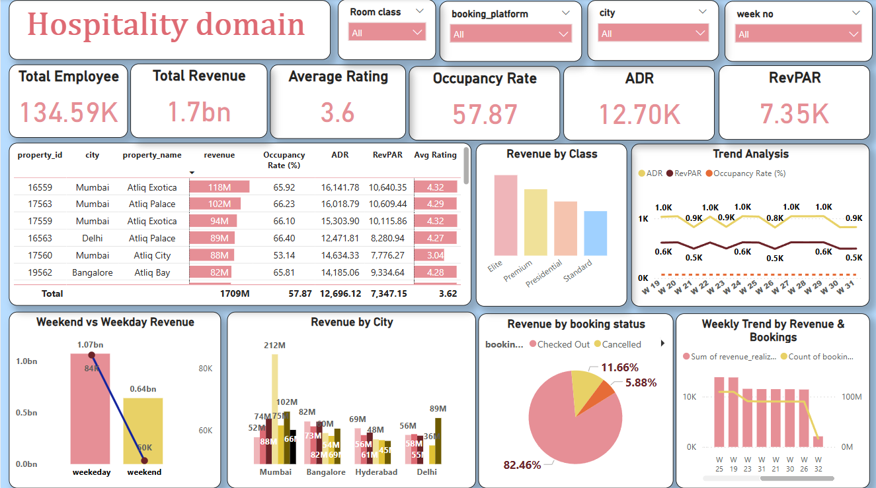
Power BI Dashboard

Slide 9
SQL Query
Trend Analysis
SELECT check_in_date, count(booking_id),
COUNT(CASE WHEN booking_status = 'checked out' THEN 1 END) AS occupied_rooms,
COUNT(DISTINCT booking_id) AS available_rooms,
ROUND((COUNT(CASE WHEN booking_status = 'checked out' THEN 1 END) / COUNT(DISTINCT booking_id)) * 100, 2) AS occupancy_rate,
ROUND(SUM(revenue_realized) / NULLIF(COUNT(CASE WHEN booking_status = 'checked out' THEN 1 END), 0), 2) AS adr, ROUND(SUM(revenue_realized) / NULLIF(COUNT(DISTINCT booking_status), 0), 2) AS revparFROM fact_bookings fb GROUP BY check_in_date;
Class Wise Revenue?
Select dm.room_class, sum(fb.revenue_realized) as Total_Revenue
from fact_bookings fb join dim_rooms dm on fb.room_category=dm.room_idgroup by dm.room_classorder by total_revenue desc;
      Checked out cancel No show?
SELECT booking_status, count(booking_id), sum(revenue_realized) as total_revenue
/* CASE WHEN booking_status = 'Checked Out' THEN 'Checked Out' WHEN booking_status = 'Cancelled' THEN 'Cancelled' ELSE 'No-Show' END AS hotel_booking_status */
FROM fact_bookings
group by booking_status;
weekend vs weekday by revenue and booking?
SELECT CASE WHEN DAYOFWEEK(check_in_date) IN (6, 7) THEN 'Weekend' -- Sunday (1) and Saturday (7) ELSE 'Weekday' END AS day_type, COUNT(booking_id) AS total_bookings, SUM(revenue_realized) AS total_revenue, ROUND(AVG(revenue_realized), 2) AS avg_revenue_per_bookingFROM fact_bookingsGROUP BY day_typeORDER BY day_type;
        Weekly trend Key trend (Revenue, Total booking, Occupancy)
SELECT sum(revenue_realized) as Revenue , count(booking_id), WEEK(check_in_date, 7) AS booking_week, -- Week number (1 = sunday start)
COUNT(CASE WHEN booking_status = 'checked out' THEN 1 END) AS occupied_rooms, COUNT(DISTINCT booking_id) AS available_rooms,
ROUND((COUNT(CASE WHEN booking_status = 'checked out' THEN 1 END) / COUNT(DISTINCT booking_id)) * 100, 2) AS occupancy_rate,
ROUND(SUM(revenue_realized) / NULLIF(COUNT(CASE WHEN booking_status = 'checked out' THEN 1 END), 0), 2) AS ADR,
ROUND(SUM(revenue_realized) / NULLIF(COUNT(DISTINCT booking_status), 0), 2) AS revpar
FROM fact_bookings WHERE check_in_date BETWEEN '2022-05-01' AND '2022-07-31’
GROUP BY WEEK(check_in_date, 7) ORDER BY booking_week;
Revenue by State & hotel?
Select sum(fb.revenue_realized), dh.city, dh.property_name
from
fact_bookings fb join dim_hotels dh on fb.property_id=dh.property_id
group by dh.city ,dh.property_name;

Slide 10
Key Metrics
Revenue Realized - 1,708.771,229
Total Guest -274,134
Total Bookings – 134, 590
Avg Rating – 3.62
Cancellation Rate – 24.83%
Occupancy Rate- 57.87%
ADR – 12.696
RevPAR – 7,347

Slide 11
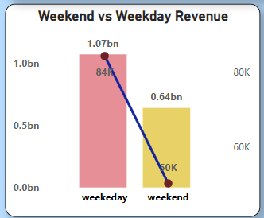
Day type vs Revenue insight
During Weekdays,the revenue totals 1.07 B Rupees,representing 63% of total revenue
During Weekend,the revenue totals 0.64 B Rupees,representing 37% of total revenue
Customer Behavior : The chart can reflect customer preferences, with weekends attracting more guests, possibly due to higher prices,business-related stays.

Slide 12
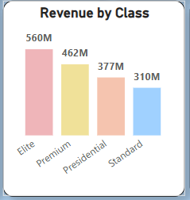
Class Wise Revenue
Class wise Performance : The chart highlights revenue distribution across different classes like Elite, Premium, Presidential, and Standard.
Higher revenue from Elite at 560M and lowest from Standard class at 310M.
Revenue Trends : Analyzing trends by class helps identify which segments are growing or declining, guiding pricing and service adjustments.

Slide 13
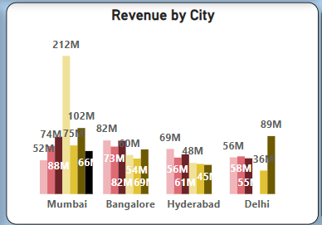
Revenue City & Hotel wise
Mumbai leads in revenue generation at followed by Bangalore.
Revenue Trends : Identifying cities or hotels with increasing or declining revenue can help pinpoint areas of growth or concern.

Slide 14
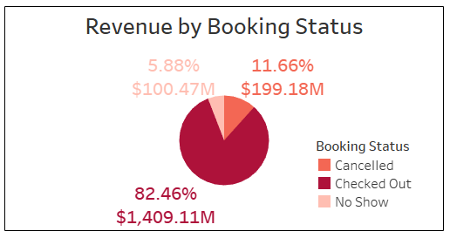
Checked-out , Cancelled and No show
Checkout (82%) indicates good occupancy and customer retention.
Cancellation (12%) signifies the need to reduce cancellations through better policies or incentives.
No-Show (6%): A smaller percentage but can impact revenue
Customer Behavior reflects that majority complete their stays, but a notable portion cancel or do not show up.

Slide 15
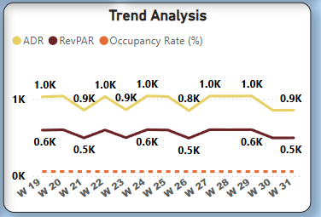
Trend Analysis
While ADR shows some variability, RevPAR remains relatively stable, implying consistent revenue management despite price fluctuations.
Further analysis should consider external factors (seasonality, local events, etc.) to provide a more comprehensive understanding of these trends.
It would be beneficial to compare this data with previous years or industry benchmarks to assess performance accurately.
Pricing Strategy Evaluation: The fluctuations in ADR could be due to dynamic pricing strategies. Analyzing the factors influencing these changes could help optimize pricing for maximum revenue.
Competitor Analysis: Comparing these metrics with those of competitors in the area could provide valuable insights for strategic decision-making.

Slide 16
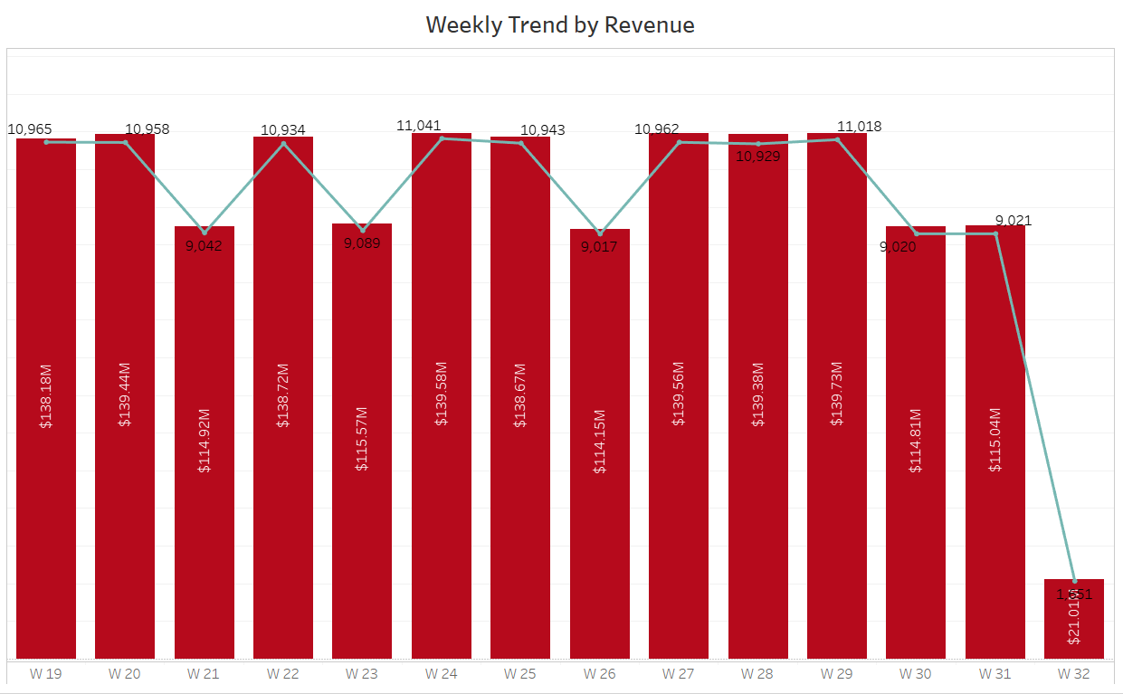
Weekly Trend
The provided image depicts a weekly trend of revenue in the hospitality industry.
Key observations include:
Weeks 19 through 31 show relatively stable revenue, fluctuating between approximately $138 million and $140 million, with dips to around $114-$115 million in weeks 21, 23, 26 and 30.
Peak Revenue:
The highest revenue is observed around weeks 20 and 24, reaching approximately $139.44M and $139.58M, respectively.
Lowest Revenue:
The lowest revenue occurs in week 32, with a sharp decline to $21.01M because of data availability.
Fluctuations:
There are notable dips in revenue around weeks 21, 26 and 30, indicating potential variations in business performance during these periods.

Slide 17
Major Insights
Weekday revenue surpasses weekend revenue, indicating stronger demand and booking activity during the workweek.
Mumbai is the top-performing city in terms of earnings, with Atliq Exotica playing a central role in driving its revenue.
The Elite category generates the highest revenue compared to other room categories, likely due to its premium offerings and higher pricing.
The 70% checkout rate indicates solid occupancy and successful customer retention, suggesting that most customers are completing their stays
Direct offline bookings are relatively low, totaling 3.2K, while bookings made through other platforms tend to have higher ratings, likely due to the convenience, promotions, and visibility these platforms offer

Slide 18
Future Recommendations
1️⃣ Smart & Contactless Experiences
🔹 Mobile check-in/out, digital keys, and touchless payments
🔹 Smart room features for seamless guest control
2️⃣ Sustainable & Wellness-Focused Stays
🔹 Eco-friendly operations, energy-efficient tech, and waste reduction
🔹 Wellness offerings like yoga, spa, and healthy dining
3️⃣ Tech-Enabled Workforce & Personalization
🔹 Train staff in digital tools for enhanced guest service
🔹 AI-driven personalized experiences & loyalty programs
4️⃣ Security, Accessibility & Community Impact
🔹 Strong cybersecurity to protect guest data
🔹 Inclusive spaces & active local community engagement

Slide 19


